Slide 1
Project Quality Management

Slide 2
Control Quality Tools and Techniques
Data Gathering including Checklists, Statistical Sampling and Questionnaires and Surveys
Data Analysis including Performance Review and Root Cause Analysis
Inspection including various Sampling techniques such as Statistical, Attribute and Variable Sampling
Testing and Product Evaluations
Quality Control Meetings and Discussions
Data Representation including Check Sheets, Histograms, Pareto Charts and Scatter Diagrams
Diagnostic tools including Ishikawa and Control Chart
 | PMBOK® Guide, 6th Ed. Section 8.3

Slide 3
Control Quality Tools & Techniques
Check Sheets
Also known as tally sheets are used as checklists for gathering data
Are used to record and organize data in real time when it is generated
Data such as data attributes are about quality defects
Defect Category | Week 1 | Week 2 | Week 3 | Total
Critical | 1 | 2 | 2 | 5
High | 3 | 4 | 2 | 9
Medium | 5 | 6 | 3 | 14
Low | 2 | 4 | 5 | 11
Total | 11 | 16 | 12 | 39
 | PMBOK® Guide, 6th Ed. Section 8.3

Slide 4
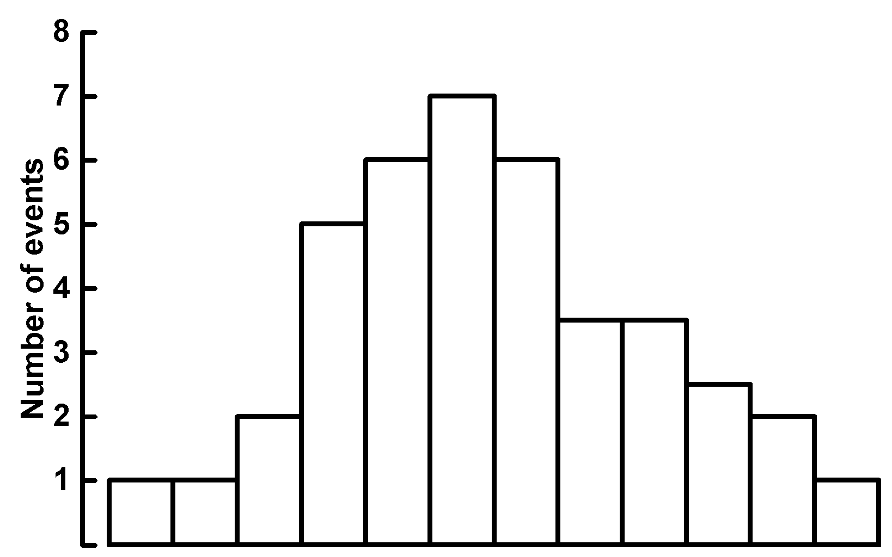
Control Quality Tools and Techniques
Histogram
Is special form of bar chart showing statistical distribution
Each column represents an attribute of a problem
The height of each column represent the relative frequency of the attribute
This tool helps identify the cause of the problem in a process by the shape and width of the distribution
 | PMBOK® Guide, 6th Ed. Section 8.2

Slide 5
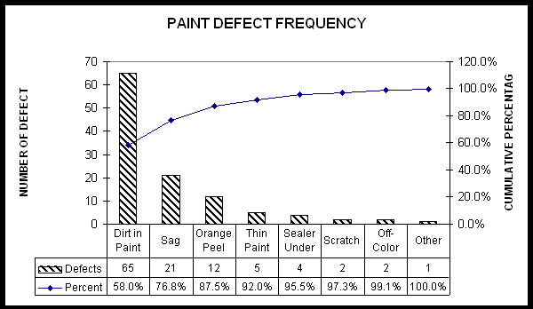
Control Quality Tools & Techniques
Pareto Chart
Is a special form of bar chart that is used to identify few factors (causes) that are responsible for the biggest share of the problem
The first few causes (20%) usually account for 80% of the problems
These causes are represented by the first few vertical bars, the height of which represent the relative frequency of occurrence
 | PMBOK® Guide, 6th Ed. Section 8.3

Slide 6
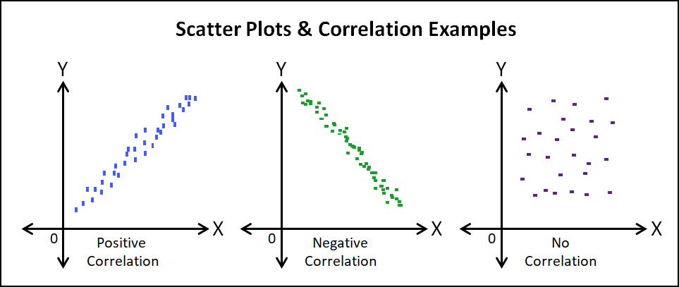
Control Quality Tools and Techniques
Scatter Diagram
Also known as correlation chart, plots ordered pairs of variables say X and Y, showing the pattern of relationship between them. The diagram helps explain whether a change in independent variable (X),causes a change in dependent variable (Y)
The result could be positive correlation, negative correlation or zero correlation
 | PMBOK® Guide, 6th Ed. Section 8.3

Slide 7
Control Quality Tools and Techniques
Cause-and-Effect Diagram
Also known as Fishbone, Ishikawa or Why-Why diagram, illustrate how various causes might be linked to potential quality problem
The analysis of possible causes lead to determination of one or more root cause which require corrective action(s)
 | PMBOK® Guide, 6th Ed. Section 8.2

Slide 8
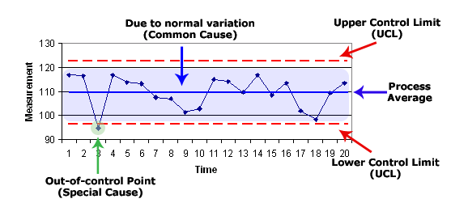
Control Quality Tools & Techniques
Control Chart
Displays interaction of process variables on a particular process to determine whether they are within acceptable limits
Developed by Walter Shewart of Bell Telephone Laboratories in New York
Determines if a process is stable, has predictable performance or out of control
 | PMBOK® Guide, 6th Ed. Section 8.3

Slide 9
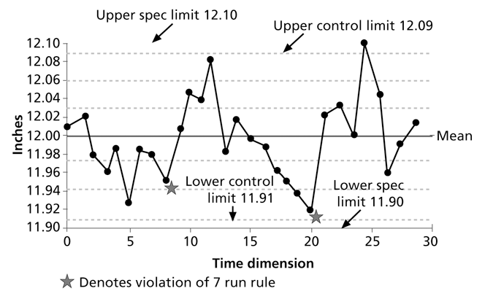
Control Quality Tools & Techniques
Control Chart
 | PMBOK® Guide, 6th Ed. Section 8.3

Slide 10
Control Quality Tools & Techniques
Control Chart (cont’d)
Indications of Out of Control Process:
Rule of Seven – 7 consecutive (grouped) data points which are non-random points fall above the mean, below the mean., increasing or decreasing, then the process is trending to be out of control.
A data point falls on or outside the upper and lower control limits. Also known as “special cause or assignable cause variation”. Cause is assigned to data point not to the process
Control Chart can be used for both project and product life cycle processes
Project – Use control chart to determine cost or time variances and whether they are in acceptable range (+/- contingency)
Product – Use to determine if number of defects are acceptable
Special Causes – Unusual events
Common causes are normal process variation. Also known as random causes due to random variation which are natural
Control limits – the process is in control if results fall within upper and lower control limits.
Specification limits – Customer acceptance limits beyond control limits
 | PMBOK® Guide, 6th Ed. Section 8.3

